Slide 1
Multisolving for Equitable Climate Solutions Using FLOWER
An Interactive, Virtual Workshop
Notes:
Potential script:
Today we are going to be learning about multisolving and then apply what we learned using a tool called FLOWER. But before we begin, let’s start with a question to get grounded (move to next slide)
**All scripts contained in this deck were written by Cassandra Breeze Ceballos**

Slide 2
What needs protecting?
(answer with a word or short phrase)
Notes:
Potential script:
What needs protecting? This doesn’t have to be about the climate or the environment. Reflect on some things in the world that need protecting.
Note to facilitators: name a couple of simple things, such as babies or birds, to get participants started. Read some answers out loud (or allow the participants to) for a few minutes before saying the script below.
Now, imagine if we could protect all those things at once? What if all these vulnerable things we named could be addressed more easily be addressing them together, rather than one by one? That’s what we call multisolving (move to next slide)
Written by: Cassandra Breeze Ceballos

Slide 3
multisolving (v): using one investment of time or effort to solve several problems at once in a way that also improves equity
Multisolving Institute (n): a think-do tank to increase the prevalence of multisolving in the world
Notes:
Note to facilitators: You can simply read these two definitions out loud, but do make sure that folks are clear about what multisolving means

Slide 4
The potential of multisolving…
Notes:
Potential script:
But what does this really mean? What does it mean to multisolve? Let’s take a look at some real-world examples (move to next slide)

Slide 5
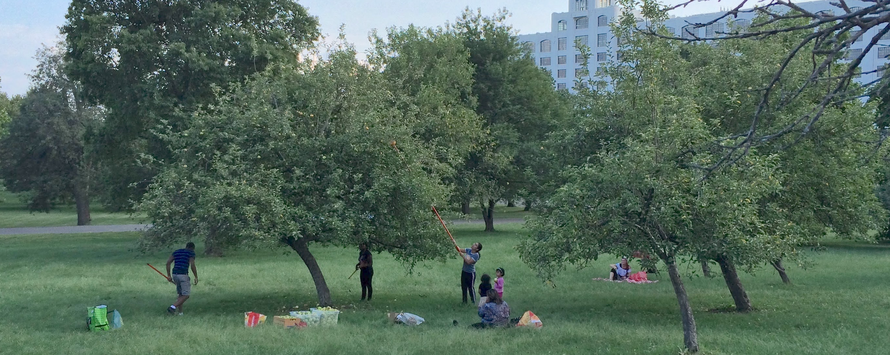
Baltimore Orchard Project in Maryland
Notes:
Potential script:
1 in 4 residents in Baltimore live in areas that lack access to fresh, nutritious, and affordable food. Rabbi Nina Beth Cardin founded the Baltimore Orchard Project in 2012 to harness the power of fruit trees to improve the lives of city residents. These trees provide communities with a variety of social, economic, and environmental co-benefits. They reduce air pollution, store carbon dioxide, cool homes and nearby areas, mitigate storm water runoff, boost mental health, improve aesthetics, reduce crime rates, and more. The project also is intentional to approach its work from an equity lens. This is done by working with neighborhood residents to design an orchard that fits their needs and space, and then training community members to tend to the orchards.
Note to facilitators: Here is a link to the PDF of the case study: https://www.multisolving.org/wp-content/uploads/2022/04/BaltimoreEdibleOrchards_updated.pdf

Slide 6
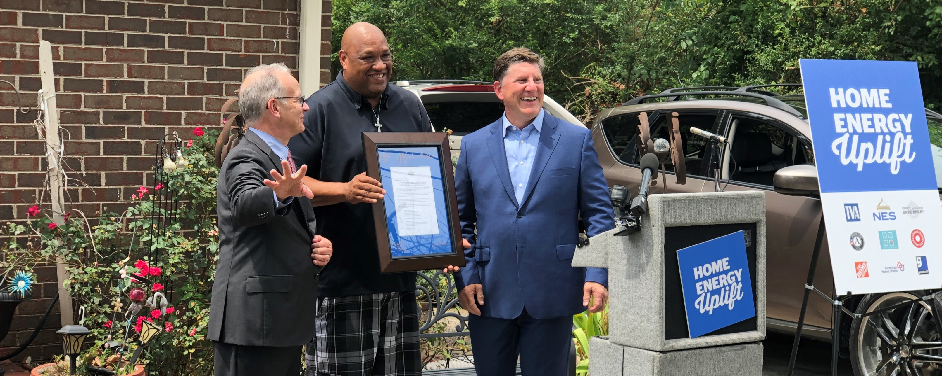
Nashville Home Uplift in Tennessee
Notes:
Potential script:
Nashville Home Uplift was a series of pilot programs aimed at reducing the energy burden (or percent of your income used for energy bills) of low-income homeowners. The project brought together many different types of workers, including government, private business, non-profits, and community service organizations to offer qualifying homeowners free weatherization. Weatherization means replacing lightbulbs and appliances like a stove to be more energy efficient. In older homes this can mean adding insulation to crawl spaces and making sure windows are tightly sealed. All these actions can improve indoor air quality, thereby reducing chronic illnesses such as asthma. Lower energy bills also means more money to spend on other needs, such as food or transportation. Unlike temporary relief programs Home Uplift is designed to make permanent changes that impact overall quality of life.
Note to facilitators: Here is a link to the PDF of the case study: https://www.multisolving.org/wp-content/uploads/2022/04/NashvilleHomeUplift_updated.pdf

Slide 7
Ciclovía in Colombia
Notes:
Potential script:
Launched by young activists in 1974, Ciclovía de Bogotá was launched in 1974 by young activists and has since spread to other parts of the country. Every Sunday and Holiday, cities across the country close 100+ miles of roadways to motorized vehicles. This is a multisolving project because it creates many co-benefits while reducing barriers to physical activity, thereby improving overall health. In addition to providing a safe space for cyclists, skaters, runners, and walkers to congregate and foster community, the project also takes cars off the road. This in turn reduces accidents and green house gas emissions.
Note to facilitators: Here is a link to the PDF of the case study: https://www.multisolving.org/wp-content/uploads/2022/05/Ciclovia-Bogota.pdf

Slide 8

Multisolving – one action, multiple solutions
Notes:
Potential script:
So again, multisolving: one action, multiple solutions… (next slide)

Slide 9
Multisolving – one action, multiple solutions
Burn less coal
Notes:
Potential script:
When we burn less coal, say by shutting down a coal-fired power plant…
(Note to facilitators: depending on your audience, say if they are younger, you can use a simpler example of burning less coal such as turning off the lights more- the important thing is to frame it in language your audience can understand and ideally relate to)

Slide 10
Multisolving – one action, multiple solutions
Long-term
Burn less coal
Protect climate
Notes:
Potential script:
The long-term benefits of burning less coal are clear: It’s going to protect the climate and help the planet because there will be less green house gases released.

Slide 11
Multisolving – one action, multiple solutions
Short-term
Long-term
Burn less coal
Improve health
Protect climate
Notes:
Potential script:
But something happens in the immediate short-term, too: health is improved. This is the health of the people living near the plant and the health of the ecosystems surrounding the area, to name just a few. There are so many short-term co-benefits to burning less coal.
(note to facilitators: again, you can tailor the level of detail you use depending on your audience)

Slide 12
Multisolving – one action, multiple solutions
Short-term
Long-term
Burn less coal
Improve health
Protect climate
Notes:
Potential script:
But now we have to stop and ask ourselves...
(note to facilitators: you can flip from this slide quickly into the next, as that is where the point is made.)

Slide 13
Multisolving – one action, multiple solutions
Short-term
Long-term
Burn less coal
Improve health
Protect climate
ASK: Whose health is being improved?
Notes:
Potential script:
You must ask yourself: whose health is being improved? Is it communities or groups who have usually benefitted from climate action? Or is it communities on the margins, those who have contributed the least to climate change yet suffer the worst of its consequences? That question, of how the co-benefits of multisolving are distributed, is what we call the role of equity in multisolving. (move to next slide)

Slide 14
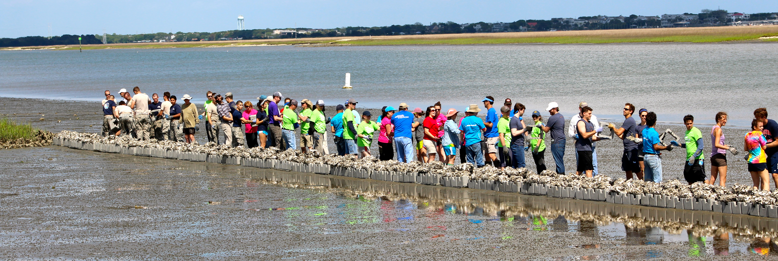
The role of equity in multisolving
Notes:
Potential Script:
Equity is central to multisolving. Around the world we live in inequitable societies (Note to facilitators: you could ask for examples of important inequities in the chat).
Multisolving is a way to create more just societies. For instance, the fossil energy system doesn’t provide equal opportunities to all groups of people. The clean energy system, if created thoughtfully, could be much more equitable. If we commit to our multisolving improving equity, then every new project contributes to making society fairer and just.
On the other hand, if people are not thoughtful about looking for and addressing inequities, then our attempts at multisolving solutions risk perpetuating inequities.

Slide 15
FLOWER
Notes:
Potential Script:
One way to evaluate what co-benefits a particular project, program, or policy may have, as well as how those benefits are distributed, is our FLOWER tool.

Slide 16
FLOWER: Framework for Long-term, Whole-system, Equity-based Reflection
Notes:
Potential Script:
FLOWER stands for “Framework for Long-term, whole-system, equity-based reflection” it is a visual tool that provides a way to open the conversation about strategies and whether there were provisions to make sure the co-benefits of multisolving would be shared fairly among groups within a community.

Slide 17
How to Read a FLOWER Diagram
People feel more connected to each other and to the earth.
Improves overall well-being and creates safe living and working conditions.
Provides meaningful work at a living wage and builds assets in a community.
Preserves the variety of life that can be found on the earth.
Builds people’s capacity to survive or even thrive in the face of disruption.
Reduces greenhouse gases emissions or boosts carbon-sequestration.
Ensures access to energy, the ability to make things they need, and the ability to get around.
Increases access to healthy food and clean water.
Notes:
(Note to facilitator: You should go through each petal one by one, perhaps naming an example as you explain what each means. End with connection at the center.)
Potential Script:
Each FLOWER petal represents seven common types of co-benefits that can result from multisolving: jobs & livelihoods, resilience, energy & mobility, food & water, climate protection, biodiversity, and health. Finally, at the center of FLOWER is connection. Let’s apply it using an example … (Walk to school case study on next slide)

Slide 18
Walk to School in the United Kingdom
Notes:
Potential script:
This is a case study from the Multisolving Institute. This example is taken from a program in the UK called “Walk to School.” Living Streets, a non-profit organization, designed the Walk to School campaign to make walking to school a safe, natural choice. This was partly in response to the discovery that the number of children walking to school had shrunk by nearly half over a generation. The project had many co-benefits, and we can now use the FLOWER tool to identify and think about those co-benefits…
(Note to facilitators: you can now open or go to the window with the “Walk to School FLOWER” google slide template and follow the steps on page 10 of the facilitator guide)
Here is a link to a PDF of this case study: https://www.multisolving.org/wp-content/uploads/2022/05/Walk-to-School.pdf

Slide 19
Demonstration
Notes:
Facilitators: Prior to facilitating this activity, you should copy and paste this google slide link into a web browser:
https://docs.google.com/presentation/d/1l6133h58_C90BLX_hLVvYD_sR23Yw2M4X-e79Q0r_xQ/edit?usp=sharing
It is a view-only template below. Copy it into your own Google slide deck or download it to your desktop. You should have it opened in a separate window prior to starting the workshop so it is ready to quickly switch to when you get to this slide during the workshop.

Slide 20
Interactive Activity – Instructions & Breakout Rooms

Slide 21
Name one insight or something that surprised you.

Slide 22
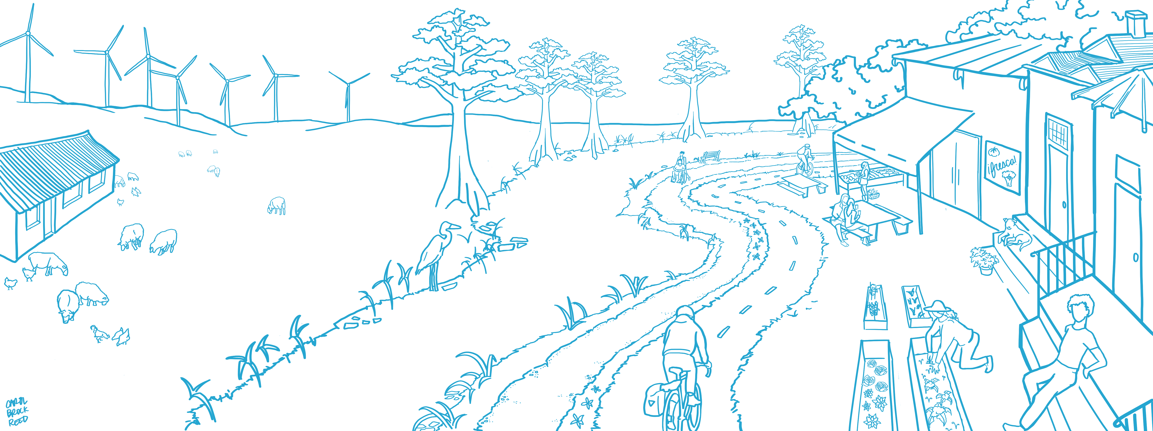

What might be possible in a world with more multisolving? What would it look like? What would there be more of?

Slide 23

Thank you! info@multisolving.org www.multisolving.org

