Slide 2
Introduction
Converging Crises, Cascading Solutions

Slide 3
Climate change is powering stronger storms and more intense wildfires. Biodiversity is falling, and the frequency of economic disruptions is quickening. In many places democracy is weakening, and in others the elite are consolidating wealth. In the face of these mutually reinforcing crises, we need different strategies for coping. The old ones seem to be proving not up to the job.
The good news is people are experimenting with different approaches around the world, designing weblike solutions for weblike problems. The very good news is that we can all learn from these experiments and add to them. It’s not too late to start. But there’s also not a moment to lose.
Notes:
Pages 1-6

Slide 4
Chapter One
Multisolving Promises and Obstacles

Slide 6
Reasons to Multisolve
1
2
3
Justice
Any policy change or investment can be designed in a way that also promotes justice.
Power
Bundling goals helps align funds, turn out more voters, and build bigger constituencies.
Synergy
Projects with long-term payoff can be boosted by the short-term benefits they also provide.
4
5
6
Efficiency
Projects that serve many goals make efficient use of time, money, and attention.
Adaptability
Working across silos creates networks that can be a source of adaptive action.
Experience of Interdependence
Multisolving gives a taste of being a valued part of an interconnected whole.
7
8
Fewer Regrets
Listening to many perspectives can identify and avoid potential problems before they happen.
Live Your Values
Multisolving allows you to incorporate more of what you care about in your work.
Notes:
Pages 20- 25

Slide 7
The quest for control
Resistance to change
Disciplinary boundaries
Obstacles to
Multisolving
Time pressures
Inequity
Jurisdictional barriers
Budget silos
Notes:
Pages 25-31

Slide 8
Chapters 2-5
Stocks, Flows, and Feedback Loops

Slide 9
Stocks
Accumulations
Nouns
Can be slow to change
Sometimes to multisolve, you need to fill a depleted stock. Other times you need to drain an overly full stock.
Image Courtesy of Pixabay
Notes:
Pages 35-47

Slide 10
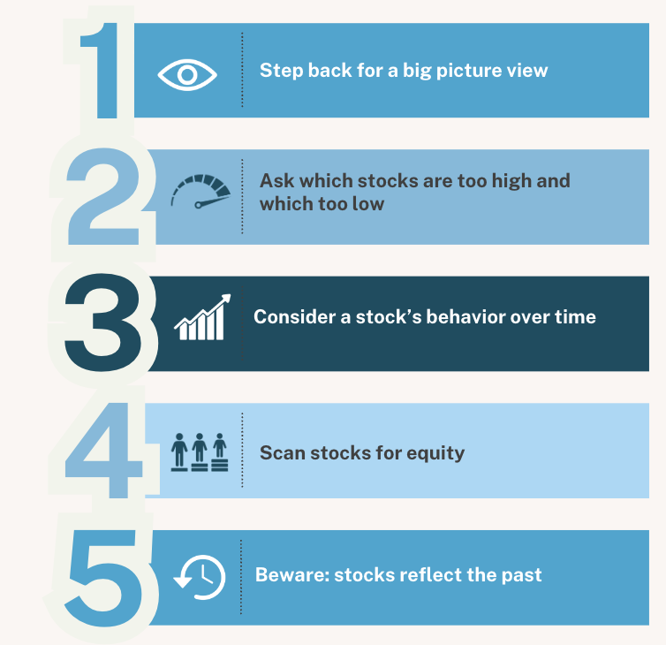
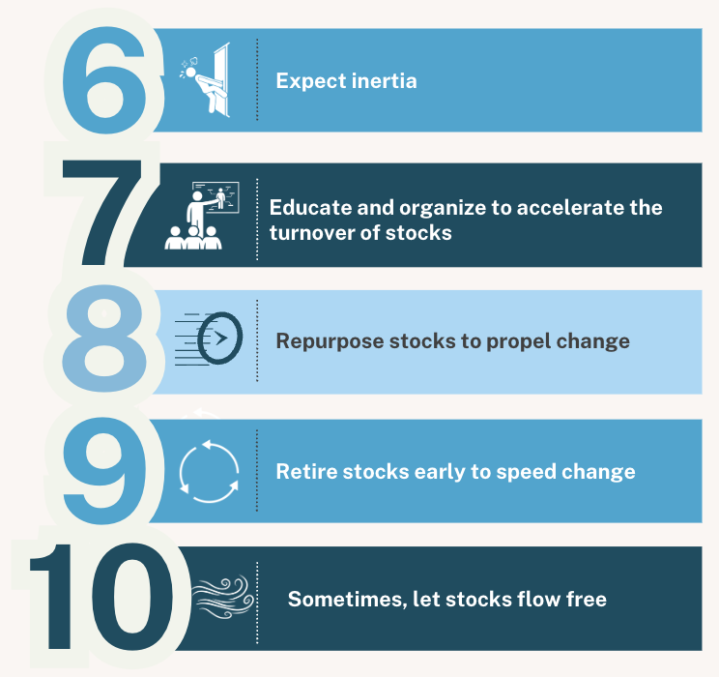
Multisolving in a World of Stocks
Notes:
Pages 40-47

Slide 11
Flows
Movement, change
Nouns per unit time
Inflows fill stocks, outflows drain them
“When you multisolve you are working with all of this flow and movement, nudging it, steering it, creating tiny new rivulets or giant rivers, or plugging holes to stop something vital from leaking away.”
Image Courtesy of Pixabay
Notes:
Pages 49-61

Slide 12
A stock will increase…
If the sum of the inflows is more than the sum of the outflows.
A stock will decrease…
if the sum of the outflows is more than the sum of the inflows.
A stock will stay steady…
if the sum of the outflows equals the sum of the inflows.
Notes:
Pages 51-52

Slide 13
Reinforcing Feedback Loops
Change that feeds upon itself
Slow change that suddenly explodes
“When someone says that ‘small changes can snowball,’ says that something ‘spreads like wildfire,’ or refers to a ‘downward spiral’ they’re talking about reinforcing feedback.”
Image Courtesy of Pixabay
Notes:
Pages 63-75

Slide 14
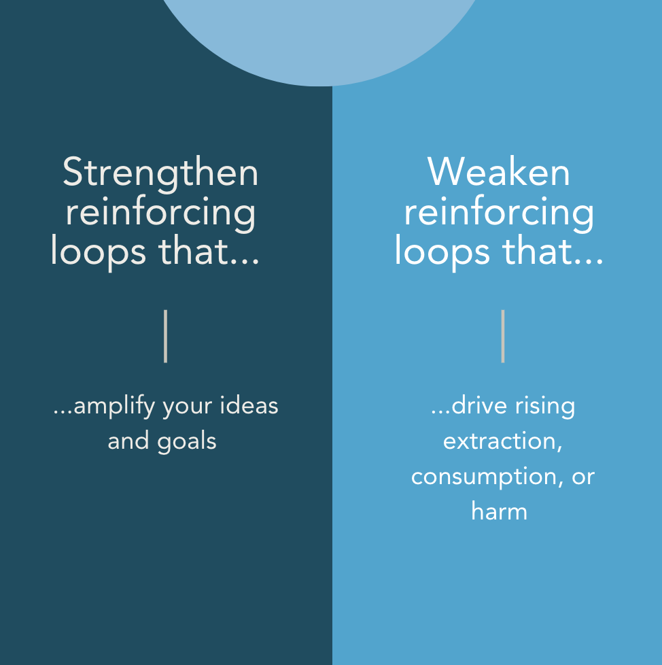
Notes:
Pages 66-75

Slide 15
Balancing Feedback Loops
Goal seeking
Change resisting
“Because of balancing feedback’s role in health, balance, and restoration, many multisolving strategies involve strengthening these loops.”
Image: Pixabay
Image Courtesy Beth Sawin
Notes:
Pages 77-89

Slide 16
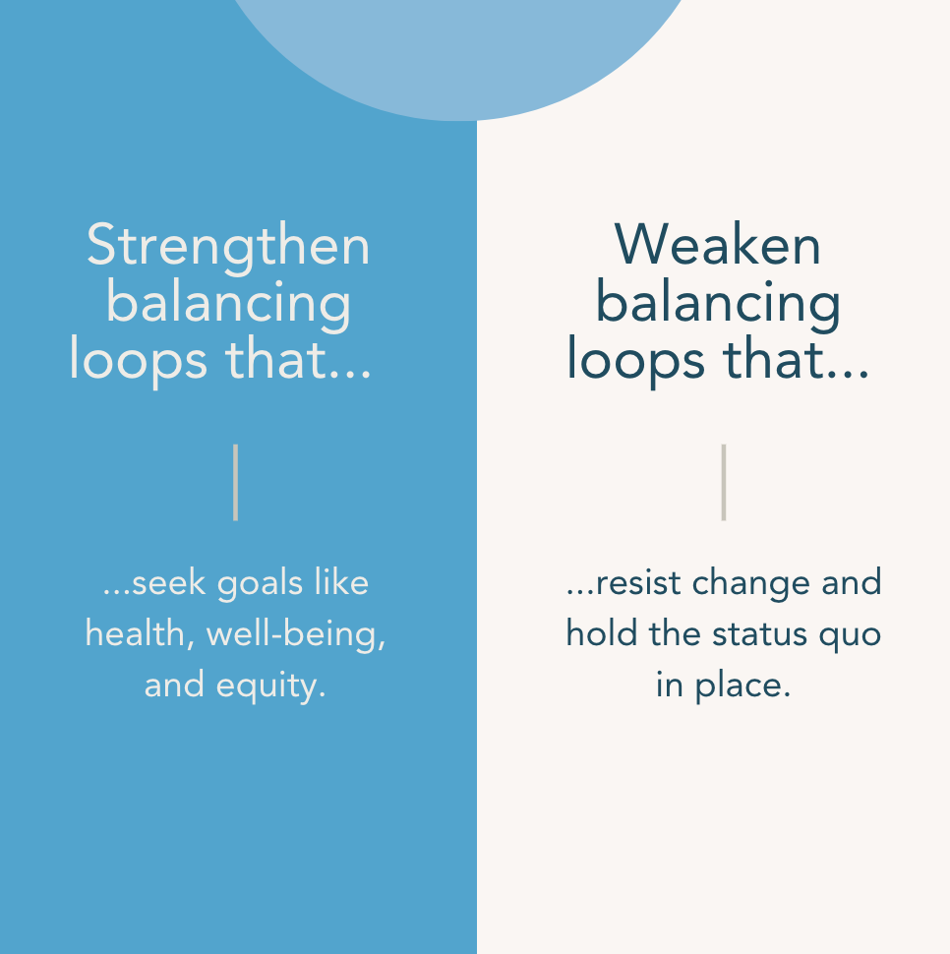
Notes:
Pages 83-89

Slide 17
Chapters 6-8
Whole Systems and Complexity

Slide 18
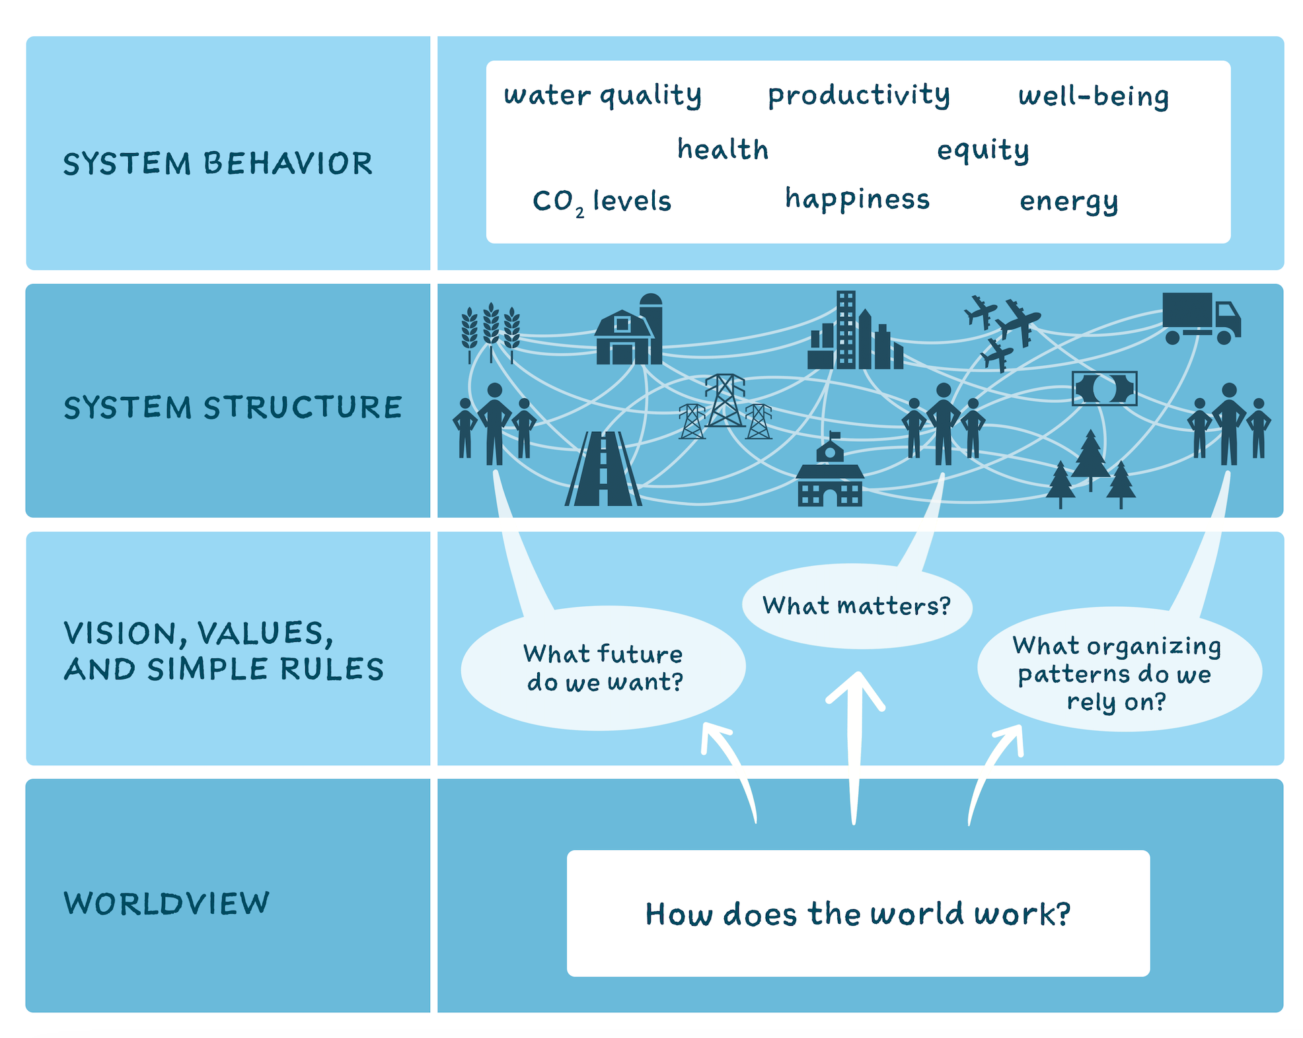
“The behavior of a system emerges from it’s structure.”
Art by Molly Schafer
Notes:
Page 95

Slide 19
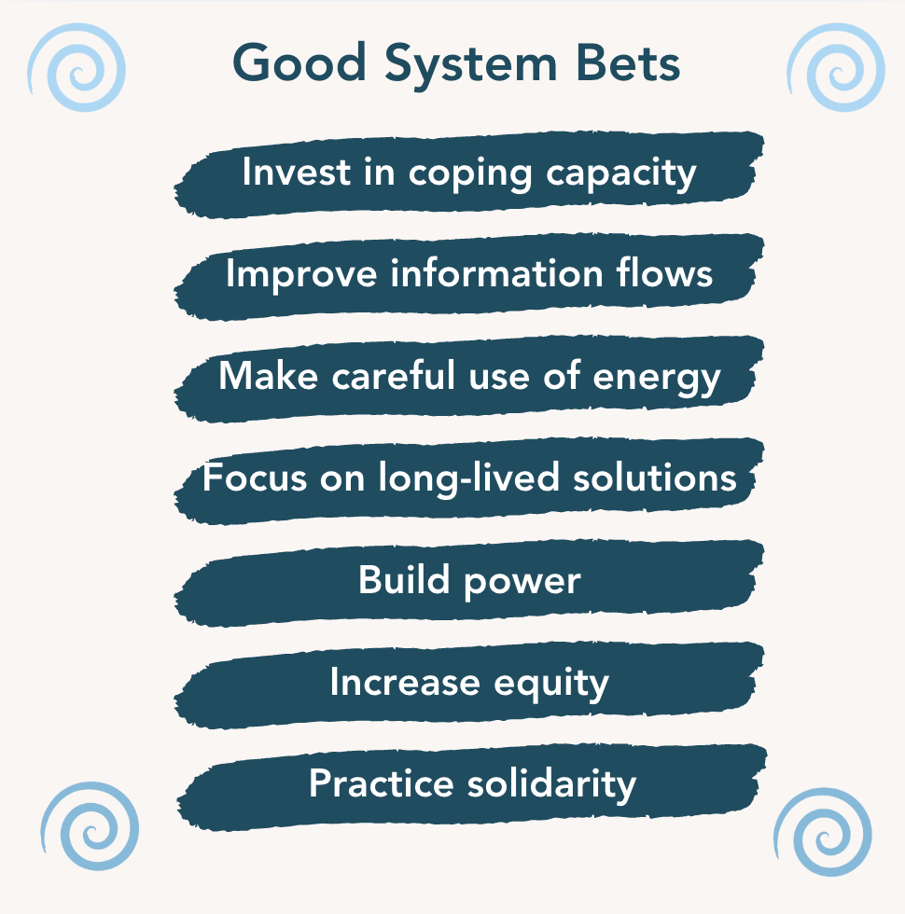
Notes:
Pages 127-133

Slide 20
“A system is coherent when similar organizing principles are used at different scales or in different domains.”
Art by Molly Schafer
Notes:
Page 148

Slide 21
Vision
Values
4 Ways to Steer Systems
Simple Rules
Worldviews
Notes:
Pages 139-163

Slide 22
Chapters 9-12
Multisolving in Action

Slide 23
RESTORING AND PROTECTING ECOSYSTEMS
ECOLOGICAL, HUMAN-SCALE COMMUNITY DESIGN
Multisolving
Solution
Clusters
EARTH AND HUMAN-CENTERED ECONOMICS
CIVIL HUMAN AND OTHER RIGHTS
CONFLICT RESOLUTION & PEACE PROMOTION
Notes:
Pages 169-171

Slide 24
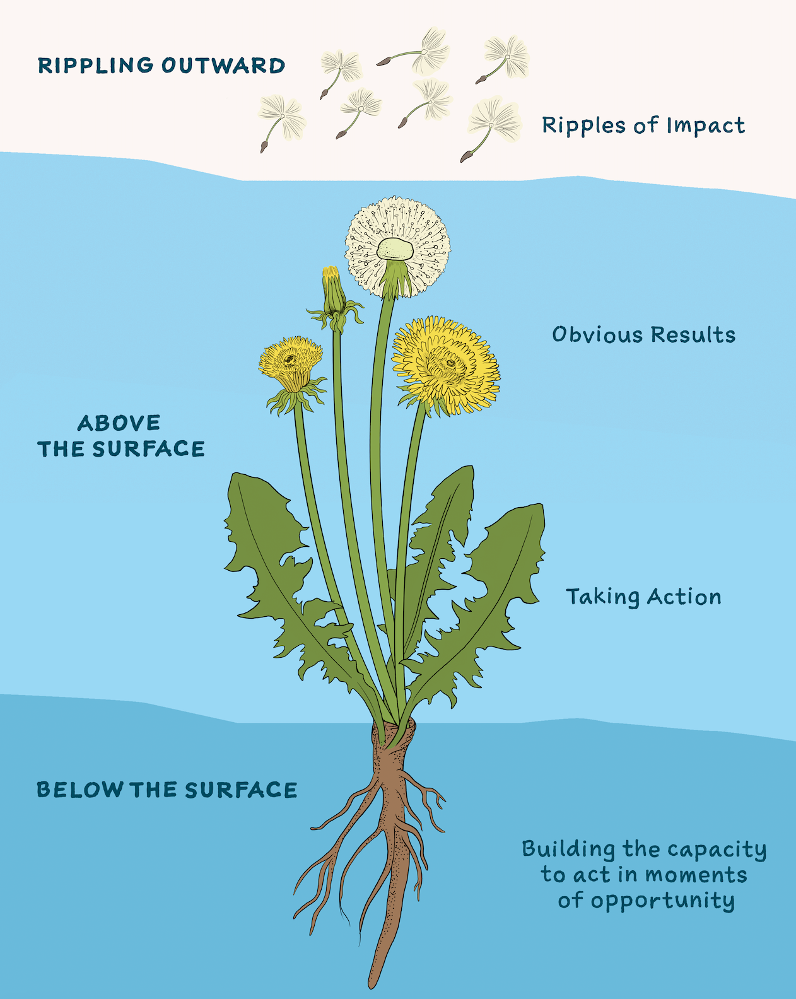
Art by Molly Schafer
Notes:
Page 166

Slide 25
Notes:
Page 197

Slide 26
In tumultuous times…
Prepare for shocks
Look to a future different from the past
Expect opportunities
Prioritize care
Notes:
Pages 205-217

Slide 27
For more information and resources see: www.multisolving.org/multisolving-the-book/

